Slide 1
OPEN NEBULA
prepared by
HET UPADHYAY(17012011060)
DHARMAY SUREJA(17012011056)
SHUBHAM SEDANI(17012011048)

Slide 2
CONTENT
Introduction
service provide by open nebula
Architecture
Advantages
key features of open nebula
Conclusion

Slide 3
INTRODUCTION
What is open nebula?
OpenNebula is a cloud computing platform for managing heterogeneous distributed data center infrastructures. The OpenNebula platform manages a data center's virtual infrastructure to build private, public and hybrid implementations of infrastructure as a service.
OpenNebula is free and open-source software, subject to the requirements of the Apache License version 2.

Slide 4
HISTORY OF OPEN NEBULA
The OpenNebula Project was started as a research venture in 2005 by Ignacio M. Llorente and Ruben S. Montero. The first public release of the software occurred in 2008. The goals of the research were to create efficient solutions[buzzword] for managing virtual machines on distributed infrastructures. It was also important that these solutions[buzzword] had the ability to scale at high levels. Open-source development and an active community of developers have since helped mature the project. As the project matured it began to become more and more adopted and in March 2010 the primary writers of the project founded C12G Labs, now known as OpenNebula Systems, which provides value-added professional services to enterprises adopting or utilizing OpenNebula

Slide 5
functionalities of open nebula
Virtualization and Cloud Management on KVM
Design the Cloud Architecture
VDC -multitedancy
simple cloud and gui provider

Slide 6
Services provided by open nebula
Amazon EC2 Query
storage
multi tedancy
vm-ware vCenter
Enterprise-Grade Infrastructure In The Cloud Age
Open Cloud Computing Interface
KVM, LXD

Slide 7
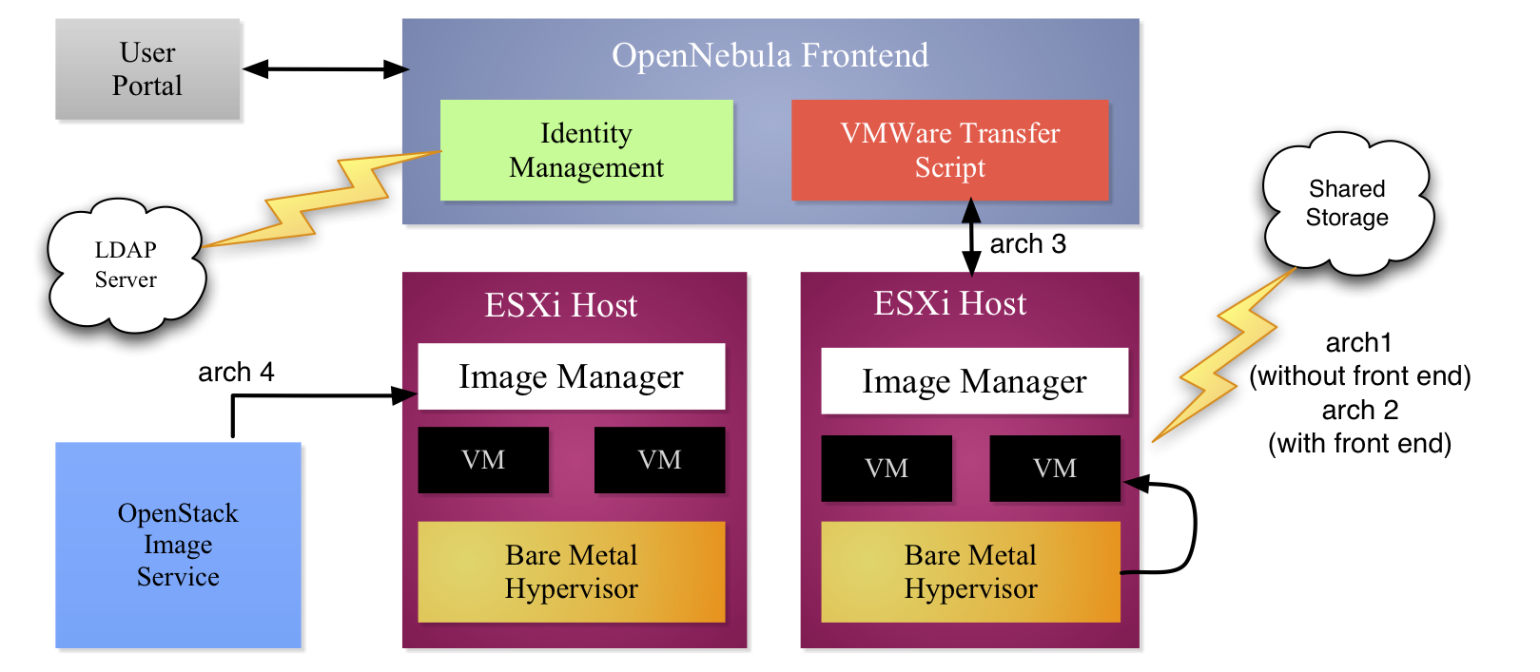
Architecture of open nebula

Slide 8

INTERNAL ARCHITECTURE
BASIC COMPONENT
Host: Physical machine running a supported hypervisor.
Cluster: Pool of hosts that share datastores and virtual networks.
Template: Virtual Machine definition.
Image: Virtual Machine disk image.
Virtual Machine: Instantiated Template. A Virtual Machine represents one life-cycle, and several Virtual Machines can be created from a single Template.
Virtual Network: A group of IP leases that VMs can use to automatically obtain IP addresses. It allows the creation of Virtual Networks by mapping over the physical ones. They will be available to the VMs through the corresponding bridges on hosts.

Slide 9
component of open nebula
1.OpenNebula Front-end – This is the management engine that executes the OpenNebula services.
2.OpenNebula Hypervisor Nodes – These are the hypervisors which provide the resources needed by the VMs.

Slide 10
Advantages of open nebula
Common template
• Richer attributes for local deployment • Specific section for each cloud provider with lmited attributes
Image Management
• Need to preregister images in S3 / Drives API • Checkpointing not allowed: no migration • Different possibilities: EC2 1 image

Slide 11
Advantages of open nebula
It is 100 per cent open source and offers all the features in one edition.
It provides control via the command line or Web interface, which is ideal for a variety of user groups and needs.
OpenNebula is available for all major Linux distributions, thus simplifying installation.
The long-term use of OpenNebula in large scale production environments has proven its stability and flexibility.
OpenNebula is interoperable and supports OCCI (Open Cloud Computing Interface) and AWS (Amazon Web Services)

Slide 12
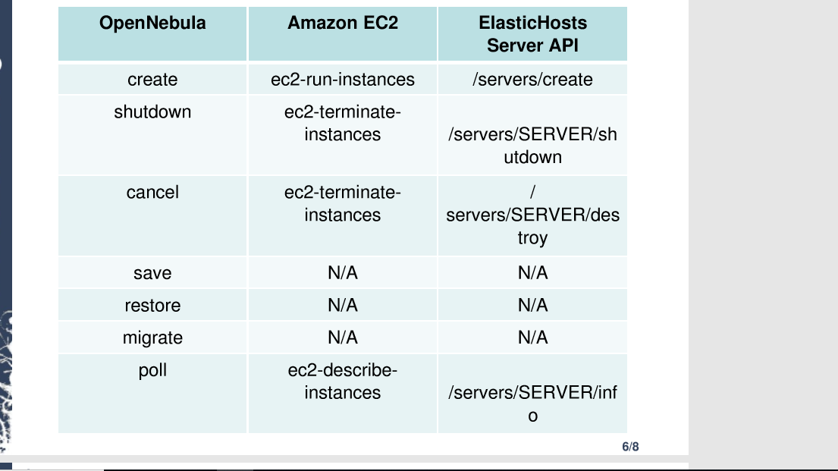
Advantages of open nebula

Slide 13
key feature of open nebula
OpenNebula offers powerful user security management,which make use of pluggable Auth Subsystem for authentication and authorization of requests. It also supports the authentication based on passwords, ssh rsa keypairs, X509 certificates or LDAP.
OpenNebula supports groups and ACLs (Access Control Lists).Groups allow administrators to isolate users and their resources from one another, while OpenNebula's implementation of ACLs allow cloud administrators to permit or deny operations for users and groups.
On-demand Provision of Virtual Data Centers(VDC) is the yet another feature which Open Nebula offers.A Virtual Data Centers (VDC) is a fully-isolated virtual infrastructure environment where a group of users, under the control of the VDC administrator, can create and manage compute, storage and networking capacity .
Advanced Control of Virtual Infrastructure by use of Image/Template repository subsystem with catalog and complete functionality for VM image/template management.OpenNebula offers full control of VM instance life-cycle and complete functionality for VM instance management
Effective monitoring of Virtual Infrastructure using configurable System Usage Statistics like OpenNebula Watch utility to visualize and report resource usage. OpenNebula allows for the automatic configuration of VMs which supports wide range of guest operating system including Microsoft Windows and Linux

Slide 14
Conclusion
OpenNebula is a simple, feature-rich and flexible solution for the management of virtualised data centres. It enables private, public and hybrid clouds. Here are a few facts about this solution.
OpenNebula is an open source cloud middleware solution that manages heterogeneous distributed data centre infrastructures. It is designed to be a simple but feature-rich, production-ready, customisable solution to build and manage enterprise clouds—simple to install, update and operate by the administrators; and simple to use by end users. OpenNebula combines existing virtualisation technologies with advanced features for multi-tenancy, automated provisioning and elasticity. A built-in virtual network manager maps virtual networks to physical networks. Distributions such as Ubuntu and Red Hat Enterprise Linux have already integrated OpenNebula. As you’ll learn in this article, you can set up OpenNebula by installing a few packages and performing some cursory configurations. OpenNebula supports Xen, KVM and VMware hypervisors

Slide 15
THANK YOU !!!

